Slide 1


CLICK THROUGH PREDICTION
Presentered by,
Latheesh Vijo

Slide 2
INTRODUCTION
The data type I choosed for this project is “CLICK THROUGH PREDICTION”. Click-through prediction is the process of using data and algorithms to predict whether a user will click on a particular advertisement. This is an essential task in digital marketing and online advertising, as it helps businesses understand user behavior and optimize their ad campaigns to increase engagement
and conversions

Slide 3
OBJECTIVES
* Look at the data to understand it better
* Fix any missing or messy data
* Create useful features for the model
* To make a better predictive model
* Check how well the model works using metrics like accuracy and precision.

Slide 4
Column Details:
1.Daily Time Spent on Site: The amount of time (in minutes) that a user spends on the website daily.
2.Age: The age of the user.
3.Area Income: The average income of the geographical area where the user resides.
4.Daily Internet Usage: The amount of time (in minutes) that a user spends on the internet daily.
5.Ad Topic Line: The headline or topic line of the advertisement.
6.City: The city where the user is located.
7.Gender: The gender of the user (e.g., Male, Female).

Slide 5
Column Details:
8.Country: The country where the user is located.
9.Clicked on Ad: The target variable indicating whether the user clicked on the advertisement (1) or not (0).
10.Hour: The hour of the day (0-23) extracted from the timestamp when the user interacted with the ad.
11.Day: The day of the month (1-31) extracted from the timestamp when the user interacted with the ad.
12.Month: The month (1-12) extracted from the timestamp when the user interacted with the ad.
13.Year: The year extracted from the timestamp when the user interacted with the ad.

Slide 6
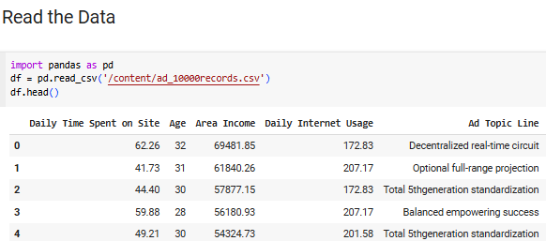
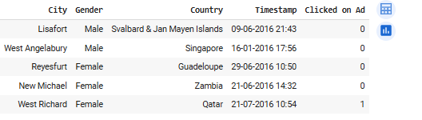

Slide 7
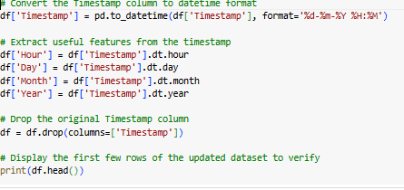
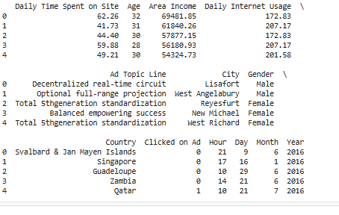

Slide 8
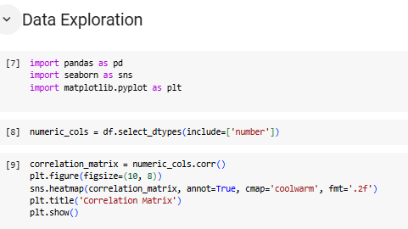
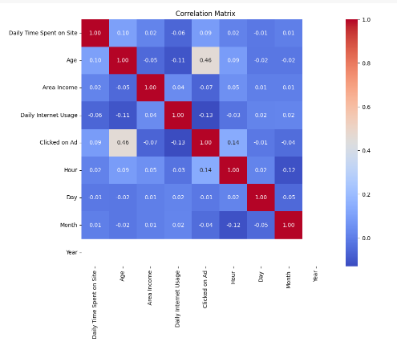

Slide 9
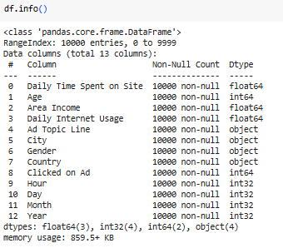
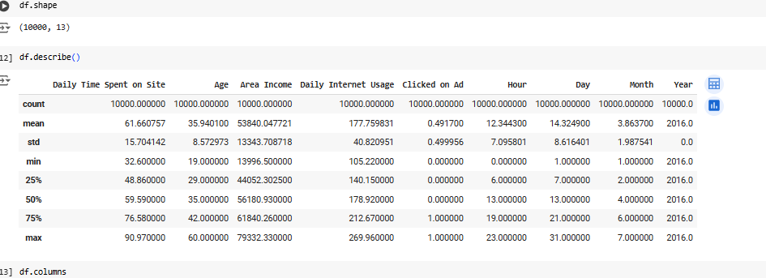

Slide 10
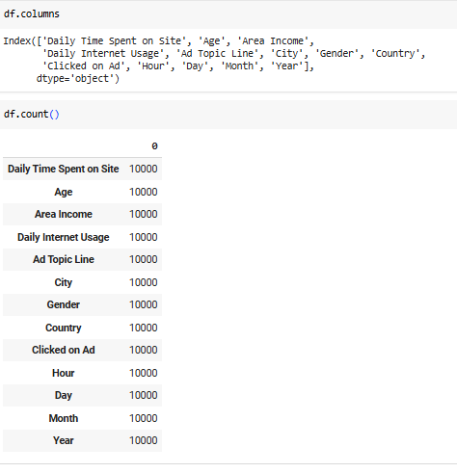

Slide 11
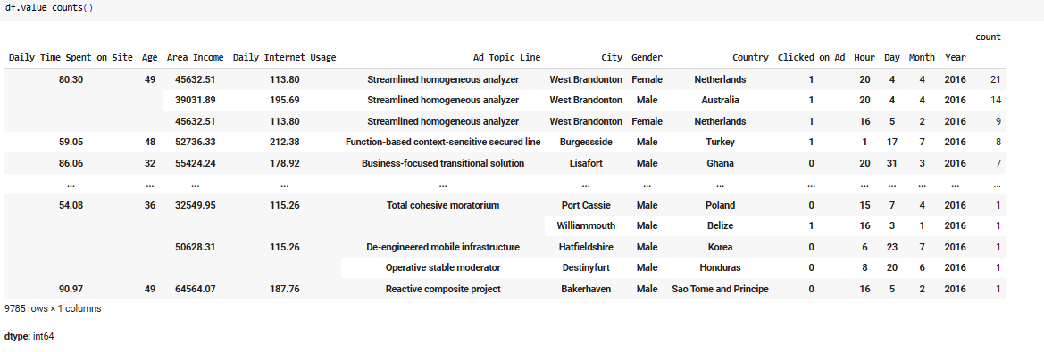

Slide 12
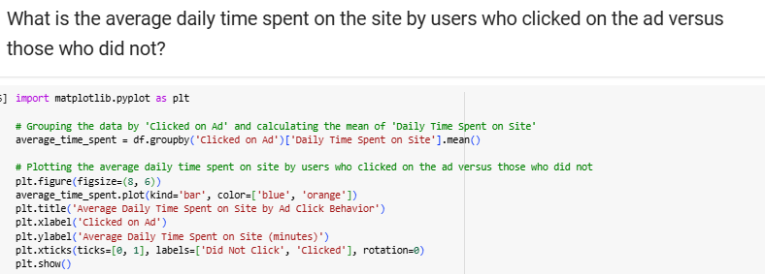
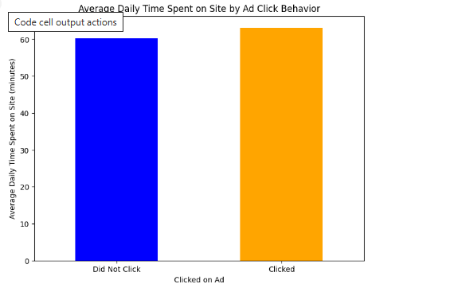

Slide 13
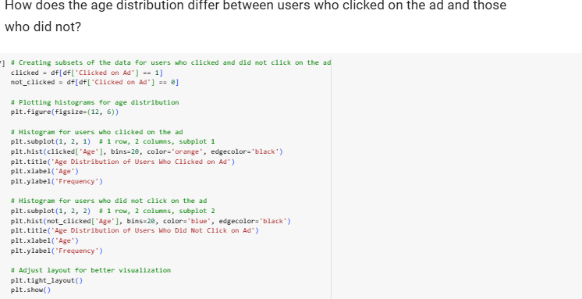

Slide 14
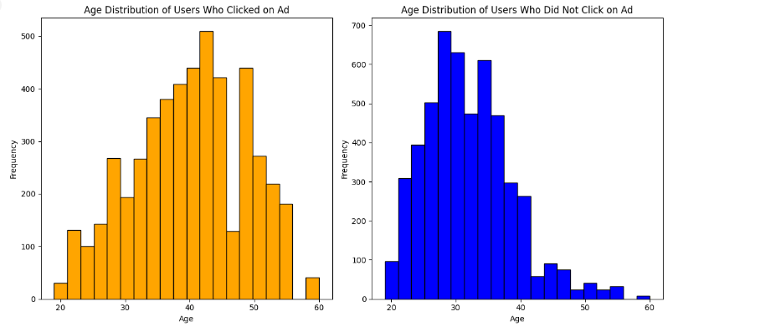

Slide 15
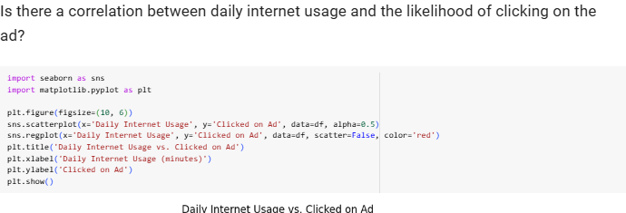
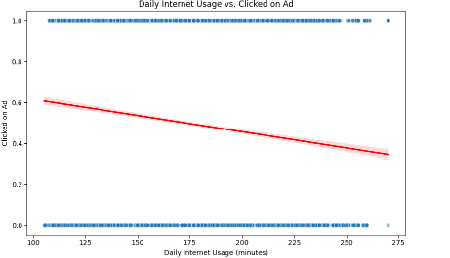

Slide 16
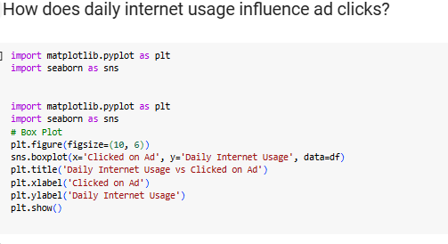
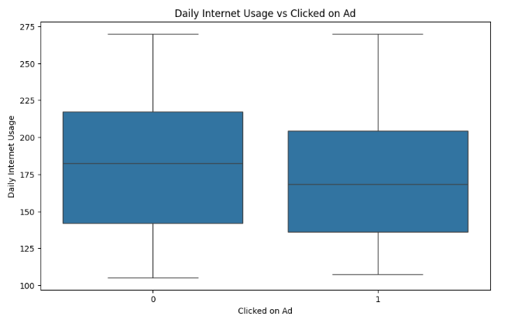

Slide 17
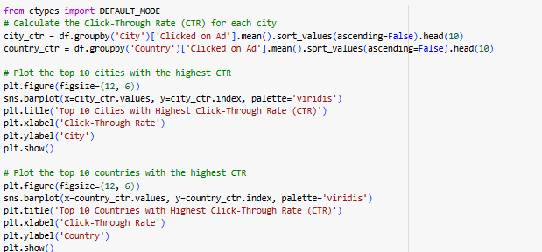
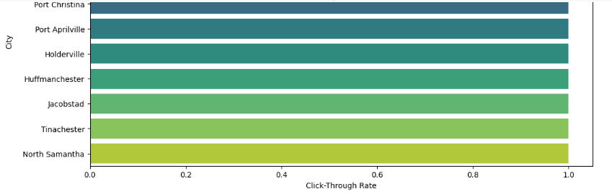

Slide 18
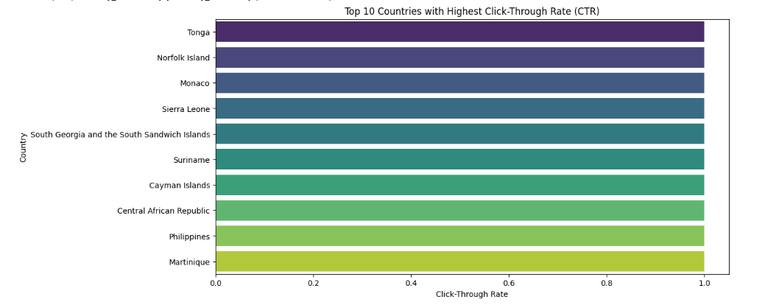

Slide 19
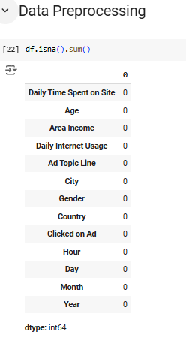
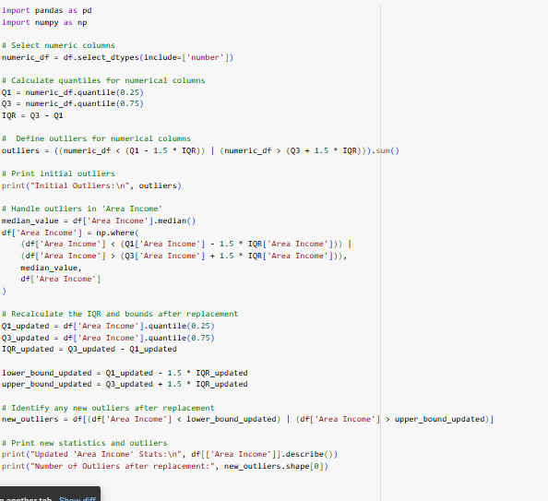

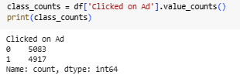

Slide 20
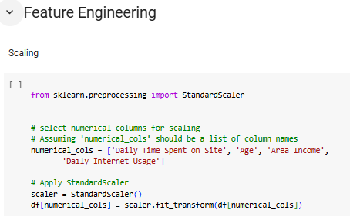
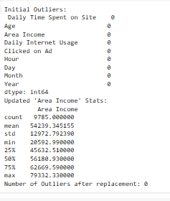
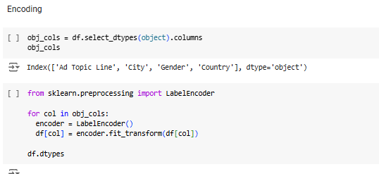
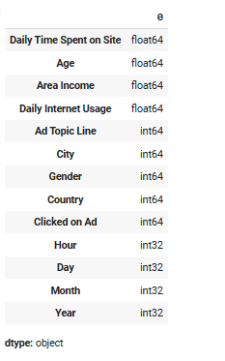

Slide 21
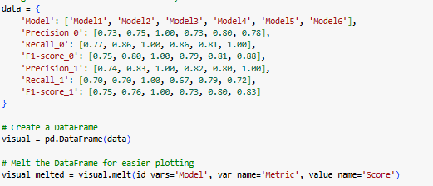
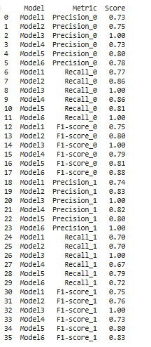

Slide 22
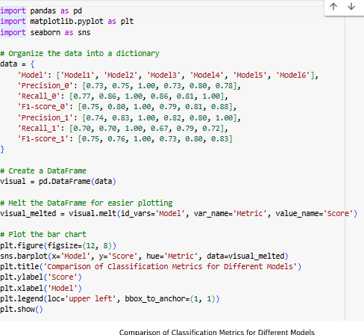

Slide 23
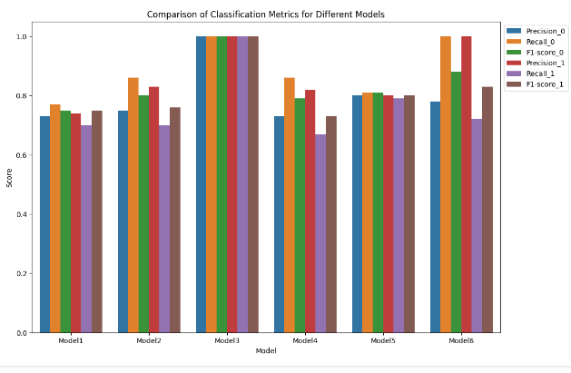

Slide 24
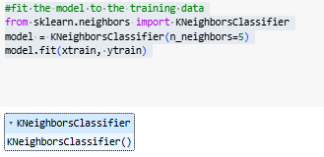
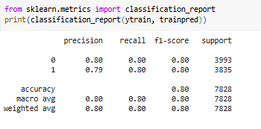
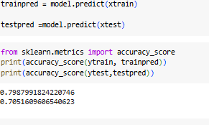

Slide 25
COCLUSION:
Based on the analysis and model evaluation, the project likely involved building a classification model to predict whether a user would click on an advertisement based on various demographic and usage features.
The k-Nearest Neighbors (k-NN) model with 5 neighbors performed well on the training data, achieving an accuracy of nearly 80%. It also generalized fairly well to the test data, with a test accuracy of around 70.52%. The model maintains a balanced performance between precision and recall for both classes, indicating it is effective at both identifying when a user will click on an ad and when they will not.

